Slide 1
Health Tech
Team Trojans
Team Members:
Alantina Mathew Jyothika Suresh Riya Varghese Swedha Shaji

Slide 2
Introduction
Nowadays Health sector is a fast-growing field. But even though it grows day by day it faces many challenges. So we the team Trojans are here to discuss the problems and the solutions based on Health Tech through CIS Hackathon.
Our main goal is to develop an integrated system for hospitals for the accessing of patient’s medical records

Slide 3
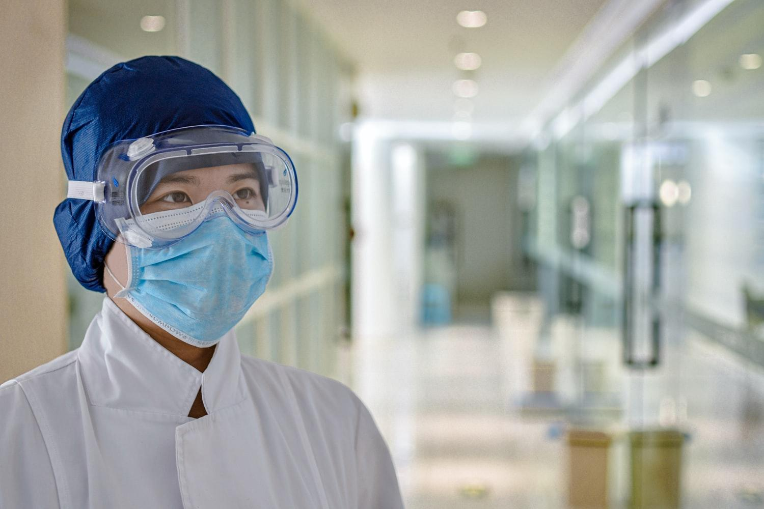
Project Summary
Health care changes dramatically because of technological developments. Our main goal is to develop an integrated system among hospitals to exchange information on the patient’s treatment history. Each hospital will be linked to a common database and the patient's information can be accessed by entering the Aadhar Number where all the information are stored in cloud.

Slide 4
HospitalHos
Database
Hospital

Slide 5
The idea behind the project title is to develop a web application which integrate all hospitals to exchange information on the patient treatment.
Nowadays ,Every hospital is taking patients adhar card number as a record.
When a patient visit other hospital (Hospital A), the hospital authorities can access that patients medical record from the hospital (Hospital B)that he visiting regularly by using adhar card number.
When Hospital A request for the information with reason ,Hosital B verifies the adhar card number and reason .
Then,Hospital B responds to the request with a brief discssion of the patients medical history

Slide 6
For storing Data we are using a non relational database like MongoDB.
A transition from relational to the non- relational database could help healthcare service providers handle large and unstructured data.
As the company grows and the flow of data increases, the database’s architectures can be scaled to make room for the new data.

Slide 7
CONCLUSION
The Healthtech today facing so many challenges, we are trying to figure out those challenge by making an Integrated Hospital Management System.
If only we have a good health tech, we can improve our health life style

